Slide 1
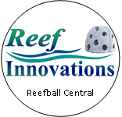


Worldwide
Marine Restoration
Educators
Volunteers
Click to start
National, State & Local Governments
International Governments and Communities
Researchers
Non-profit
Organizations
Contractors

Slide 2
Worldwide
Marine Restoration
Educators
Volunteers
Click to start
National, State & Local Governments
International Governments and Communities
Researchers
Non-profit
Organizations
Contractors
Notes:
Organization and connectors

Slide 3
Worldwide
Marine Restoration
Educators
Volunteers
Click to start
National, State & Local Governments
International Governments and Communities
Researchers
Non-profit
Organizations
Contractors
Notes:
Organization WEB

